Slide 1
Recovery Oriented Computing (ROC): Motivation, Definition, Techniques, and Case Studies
Technical Report UCB 2002
David Patterson, Aaron Brown, Pete Broadwell, George Candea, Mike Chen, James Cutler, Patricia Enriquez, Armando Fox, Emre Kıcıman, Matthew Merzbacher, David Oppenheimer, Naveen Sastry, William Tetzlaff , Jonathan Traupman, and Noah Treuhaft
Notes:
This paper was a technical reports from UCB published in 2002. The authors are mainly from UCB and Stanford.
This is like their view on what topic should the future research focus on. They advocate that the research and developing community should focus more on the dependability, to be more specific, focus on recovery oriented computing.

Slide 2


Author: David Patterson
Professor of CS at the UC Berkeley since 1976
Won the 2017 Turing Award for work in reduced instruction set computer (RISC) design
Also noted for research on redundant arrays of inexpensive disks (RAID) storage together with Randy Katz and Garth Gibson.
Co-authored books, "Computer Architecture: A Quantitative Approach" widely used as textbooks.
Notes:
The first author is David Patterson, I guess him is well known enough and probably no need to introduce.

Slide 3
Outline
Motivation
Learn from other fields
Case study: six ROC techniques
Notes:
THe outline of this presentation, I will talk about their motivation for the recovery oriented computing,
then talk about what they learned from other fields,
and finally six case studies for six ROC techniques to give readers a whole vision of ROC.

Slide 4
Motivation
Research of last 20 years (1982-2002) neglects dependability
Goal #1 from research community (since first ASPLOS):
Improve performance
Simplifying Assumptions:
Software will eventually be bug free
Hardware MTTF is already very large (~100 years)
Maintenance costs irrelevant vs. Purchase price
Notes:
The focus of researchers for the 20 years since the first ASPLOS conference has been performance.
They feel performance is always the #1 goal and dominated the research agenda.This is based on some simplifying assumptions that …
They feel it's time to broaden it.

Slide 5
Motivation
Research of last 20 years (1982-2002) neglects dependability
Goal #1 from research community (since first ASPLOS):
Improve performance
Simplifying Assumptions:
Software will eventually be bug free
Hardware MTTF is already very large (~100 years)
Maintenance costs irrelevant vs. Purchase price
Neglected other aspects:
dependability, security, privacy, and total cost of ownership (TCO)
Notes:
What the community neglect?
they neglected other aspects of computing, while very important as well: dependability, security, privacy, and total cost of ownership (TCO).
For them, they target on Internet services. They focus on two killer metrics for such services, availability and total cost of ownership.

Slide 6
Cost of ownership >> purchase
Definition of TCO from IDC study on IT companies:
Hardware and software costs + staffing costs associated with maintaining
Administration/operations; user support; database management
HW/SW cost v.s. Salary:
salary of an sysadmin: 80K/year
AWS db.m5.8xlarge: 20K/year
Source: "The Role of Linux in Reducing the Cost of Enterprise Computing“
Notes:
First, what is cost of ownership?
The def of xxx is that COT includes
* First, the trend is the salary cost is much more than the HW/SW cost. Several trends have lowered the purchase price of hardware and software: Moore’s Law, clusters, and open source software. I am not sure about the cost of software nowadays.
In contrast, system administrator salaries have increased.

Slide 7
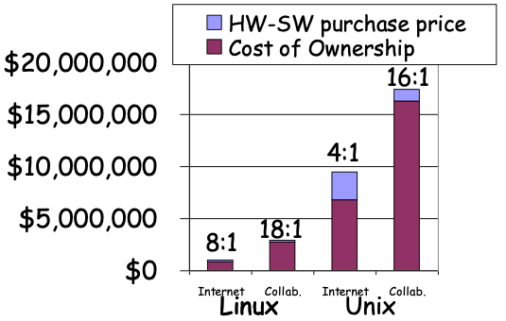
Cost of ownership >> purchase
Definition of TCO from IDC study on IT companies:
Hardware and software costs + staffing costs associated with maintaining
Administration/operations; user support; database management
HW/SW cost v.s. Salary:
salary of an sysadmin: 90K/year
AWS db.m5.8xlarge: 20K/year
TCO/purchase ratio is 5-18.
30%-50% TCO is recovering from or preparing against failures.
Source: "The Role of Linux in Reducing the Cost of Enterprise Computing“
Notes:
* There is a study from IDC on 142 companies, with average sales of $2.4B/year.
* T get the results in Figure shows that the TCO/purchase ratios are 5 to 18.
Their definition of TCO may not be clear enough as downtime cost is not included and don't know how they calculate the salary of developers. And the companies may have changed a lot in recent 20 years. So the number may not be accurate but can still learn from the conclusion.
* The survey suggests that a third to half of TCO is recovering from or preparing against failures.
So the conclusion is that the cost of recovering/dealing with failures is higher than the cost of HW and will be higher.

Slide 8
High availability not achieved
2002, Well-managed servers achieve 99.9% to 99%, or 8 to 80 hours of downtime per year.
Downtime cost per Hour
2000
Credit card authorization $2.6M
Ebay (1 outage 22 hours) $225K
Amazon.com $180K
Notes:
Another key aspect that the internet services care about is availability. But high av is not achieved.
in 2002, despite marketing campaigns says 99.999% availability, well-managed servers achieve 99.9% to 99%, or 8 to 80 hours of downtime per year.

Slide 9



High availability not achieved
2002, Well-managed servers achieve 99.9% to 99%, or 8 to 80 hours of downtime per year.
Downtime cost per Hour
2000
Credit card authorization $2.6M
Ebay (1 outage 22 hours) $225K
Amazon.com $180K
Today, Google cloud claims: 99.978%, AWS claims: 99.99%
Today
Amazon $13M
Google $ 6.5M
source: https://www.gremlin.com/ecommerce- cost-of-downtime/
Notes:
Today, google cloud and AWS claims about 4 9 availability, which means 0.8 hours a year, I doubt they really can achieve it. It may depends on how they calculate the availability but we can see several outages for Google in a year and each downtime is up to several hours.
So high availability is not achieved yet and the cost of downtime is really high.

Slide 10
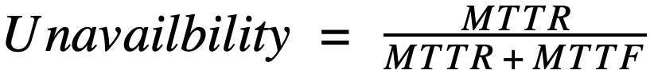
A New Research Manifesto: Recovery-Oriented Computing
How to Improve Availability and to Lower Cost of Ownership ?
“If a problem has no solution, it may not be a problem, but a fact, not to be solved, but to be coped with over time.” –Shimon Peres
Notes:
So we have that two challenges: how can we ….?
Here they quote what Peres says as the guiding proverb of Recovery Oriented Computing (ROC). former Israeli Prime Minister
They consider errors by people, software, and hardware to be facts, not problems that we must solve, you cannot completely avoid it; and fast recovery is how we cope with these inevitable errors.

Slide 11
A New Research Manifesto: Recovery-Oriented Computing
How to Improve Availability and to Lower Cost of Ownership ?
“If a problem has no solution, it may not be a problem, but a fact, not to be solved, but to be coped with over time.” –Shimon Peres
People/HW/SW failures are facts
Recovery/repair is how we cope with them
Improves availability
1/10th MTTR ≈ 10X MTTF
Side benefit: Improves TCO
Reduce downtime cost.
Reduce human component of cost.
30%-50% sys admin job is about failures.
Q: Recovery helps with MTTF a lot, not just MTTR
Notes:
They consider errors by people, software, and hardware to be facts, not problems that we must solve, you cannot completely avoid it;
and fast recovery is how we cope with these inevitable errors.
* look at the formular for unavailability is MTTR/MTTF+MTTR,
One thing we always target is to increase the MTTF.
And the authors says the MTTR is also very important.
Shrinking time to recover by a factor of ten is just as valuable as stretching time to fail by a factor of ten. If we assume that MTTF is much larger than MTTR.
From a research perspective, there may be more opportunities for improving MTTR as they feel it's not well-studied.
* A side benefit of reducing recovery time is its impact on cost of ownership. Lowering MTTR reduces money lost to downtime.
* A second benefit is lower the human component of cost of ownership. Since a third to half of a system admin’s time may be spent recovering from failures or preparing for the future failure.
So fast recovery can help reduce this cost as well.
Note that this is how they motivate the problem, but I feel when they talking about Recovery, reducing MTTR is just part of it. Because I feel recovery also helps with MTTF a lot when you mask the error, then you can have redundancy or rollforward, etc.
In their case study, they also have cases that help with MTTF, like fault injection and redundancy to survive faults.
Any questions?

Slide 12
MTTR vs MTTF
The cost of downtime is not linear
5s? 5 hour? 5 day?
Notes:
Here they compare MTTR and MTTF.
One point they mentioned is the cost of downtime is not linear, Reducing MTTR has non-linear benefits.
Five seconds of downtime probably costs little, five hours may waste a day of wages and a day of income of a company, and five days weeks may drive a company out of business for critical services like finance. Thus, reducing MTTR may have nonlinear benefits on cost of downtime.
Another example is two seconds is the threshold in terms of an average online shopper's expectation for a web page to load and they will wait no more than 2 seconds before leaving the site.

Slide 13
MTTR vs MTTF
The cost of downtime is not linear
5s? 5 hour? 5 day?
Case: Google 6 hour global outage, major outage in year
One 6-hour outage/year
What if 1-minute outage/day for a year?
360X improvement in MTTR, 365X worse in MTTF
Notes:
Let‘s think about a case for Google’s outage in Aug last year. It’s reported in news and It lasts for 6 hours while Gmail is down globally.

Slide 14
MTTR vs MTTF
The cost of downtime is not linear
5s? 5 hour? 5 day?
Case: Google 6 hour global outage, major outage in year
One 6-hour outage/year
What if 1-minute outage/day for a year?
360X improvement in MTTR, 365X worse in MTTF
Case: ground station for satellite
Target: high availability when satellite passes overhead.
Large MTTF does not guarantee a failure-free pass.
Short MTTR help not lose the whole pass.
Notes:
Another case for the ground station for the satellites that receive data and send requests to the satellites.
So they target for hhigh availability during the critical period when satellite passes overhead. This is a short time, maybe last for only several minutes.
Large MTTF does not guarantee a failure-free pass.
Short MTTR help not lose the whole pass.

Slide 15
Traditional Fault-Tolerance vs.ROC
>30 years of Fault-Tolerance research
fewer systems builders involved; ROC is for/by systems builders
Success areas for FT: airplanes, satellites, telecommunications
Hardware, software often changes slowly
Much of FT helps MTTF, ROC helps MTTR
Fault-Tolerance ignores operator error?
ROC cares all failure sources: HW, SW, and operator
Are they true?
Notes:
When they compare ROC with the traditional FT, here are some of the points they mentions
I am not quite sure about the timeline of all kinds of techniques but I feel they are not all true and many works in the FT area is not well-studied.
But it may be true that the system community may not pay enough attention to this area.

Slide 16
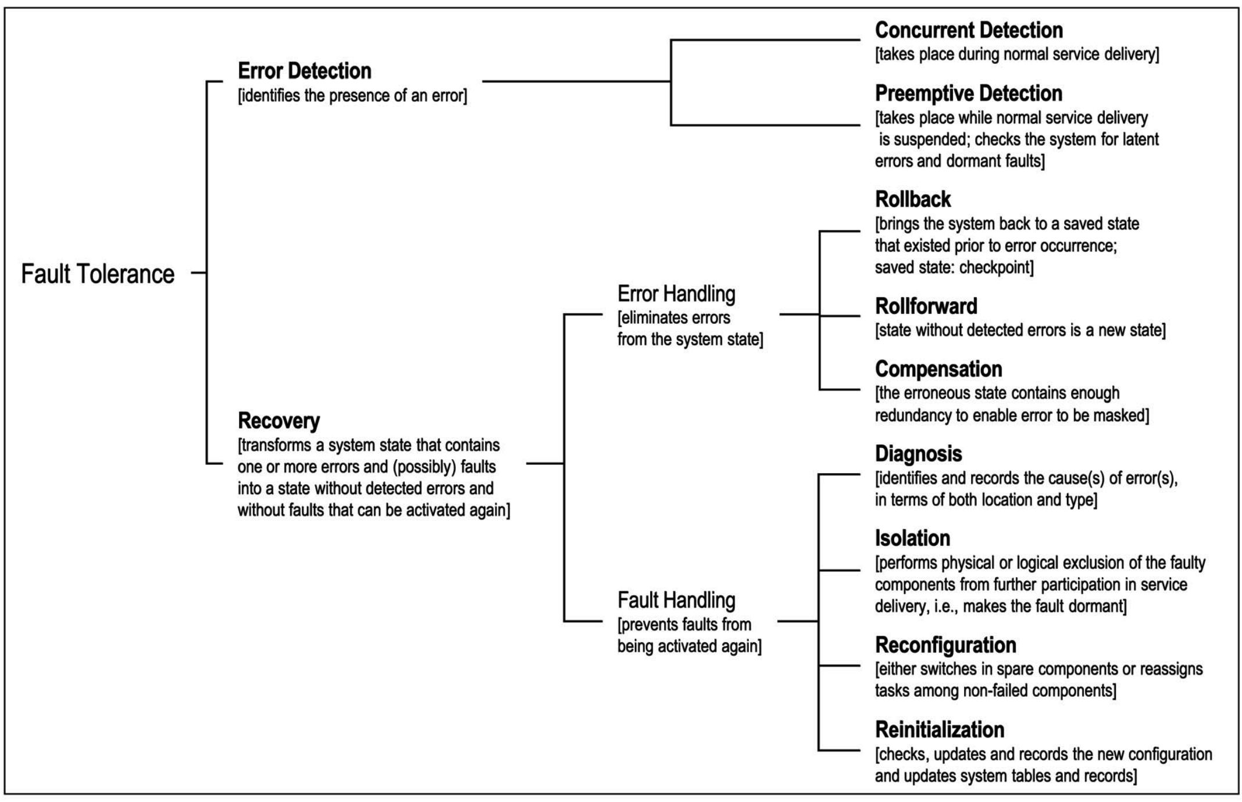
Fault-Tolerance techniques
A. Avizienis, Basic Concepts and Taxonomy of Dependable and Secure Computing, IEEE Transactions on Dependable and Secure Computing, 2004
Notes:
I guess you still remember this figure from our previous lectures that summaries the different fault tolerance techniques. We can see a large part is Recovery.
And we can see there are many related techniques like rollback, error mask (rollforward), Redunduncy that all helps with MTTF. They also care about diagnose for operators and isolation…

Slide 17
Outline
Motivation
Learn from other fields
Case study: six ROC techniques
Notes:
This is all about the motivation. Next they talk about their search for inspiration from other fields tnat led to new techniques as well as some commonly used.

Slide 18
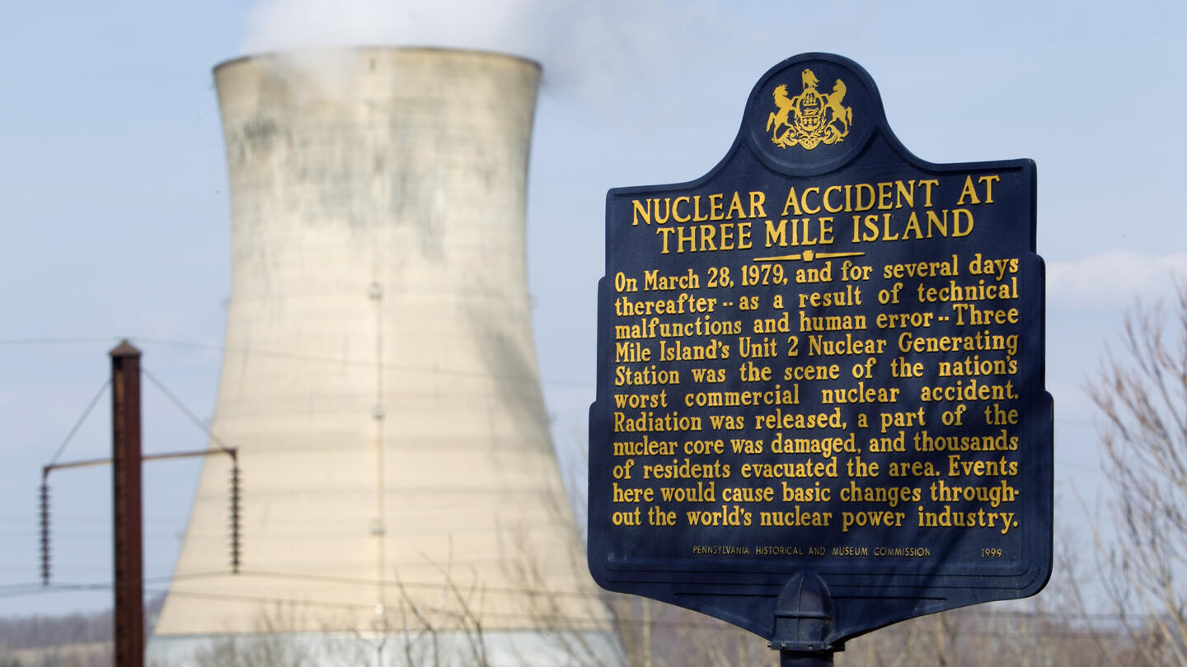
Learning from other fields: disasters
Three Mile Island nuclear reactor accident in 1979
The most significant accident in U.S. nuclear power plant history
Nuclear reactors:
large, complex, tightly coupled systems
"defense in depth": multiple layers of redundant systems.
Source: Charles Perrow, Normal Accidents: Living with High Risk Technologies, 1990
Notes:
First they study from one disaster: three …
To try to prevent disasters, nuclear reactors are large, complex, tightly coupled systems
They are also rely heavily on "defense in depth," meaning multiple layers of redundant systems.
But still, the significant accident happened.

Slide 19
Learning from other fields: disasters
Multiple failures happens, more than you believe
Correlated errors
Latent errors accumulate
Operators cannot fully understand system
State? Behavior? Impact of actions?
Blame operators afterwards?
Problems are in the design itself
Errors in implementation, measurement system, warning systems
Emergency Systems are often flawed.
parts of a redundant system used only in an emergency
Redundant backup systems failed when emergency occurred
remove latent errors
help operators cope with complexity
test recovery systems to ensure they will work
Notes:
Here are several lessons they learned:
1. multiple failures do happen together –which normally regard as statistically impossible. To some extent, these are correlated errors, but many are also latent errors also accumulate in a system, awaiting a triggering event and they happen together.
2. it is hard for operators to understand the state of the system, its behavior, or the potential impact of their actions. As a result, they may randomly try things and make things even worse.
3. Operators are blamed for disasters 60% to 80% of the time in TMI. However, this number is much too high.
People who designed the system typically do the postmortem. He believes that most of the problems are in the design itself.
There are also errors in the measurement and warning systems that make the situation worse.
4. Emergency systems are often flawed. Since many redundant part of the system is not needed for day-to-day operation, only an emergency tests them. When the emergency occurred, these redundant backup systems failed.
So it comes to several directions to cope with these lessons:

Slide 20
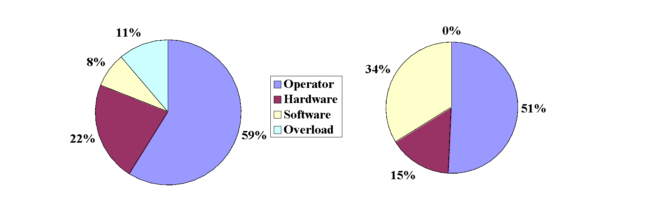
Learning from other fields: human error
Human errors are inevitable
Slips, lapses, mistakes
Human operator error is the leading cause of dependability problems in many domains
Humans can self-detect errors
about 75% of errors can self-detected
Sources of Failure
Public Switched Telephone Network
Average of 3 Internet Sites
Source: J. Reason, Human Error, Cambridge, 1990.
Notes:
Second they learn from human errors.
First, there are 3 kinds of human errors, we already covered this part in prev lectures.
Also error is leading...
From the figure, of all the source of failures more than half of them are cased by human operators.
Finally, 75% of errors can self-detected this means many such errors are slips or lapses.

Slide 21
Learning from other fields: human error
The ironies of automation:
Automation doesn’t remove human influence
shifts the burden from operator to designer
designers also make mistakes
Automation can make operator’s job harder
Reduces operator’s experience
no opportunity to learn without day-to-day interaction
Exceptional complex, rare tasks are not successfully automated
missed by (imperfect) designers
Humans are ill suited to such tasks, especially under stress.
Need tools to help, not replace, operator
Notes:
Then how to help operators with errors? Can automation help with lapse? One interesting lesson is the ironies of automation: automation does not cure the human error
First, Automation doesn’t remove human influence
once designers realize that humans make errors, they often try to design a system that reduces human intervention.
shifts the burden from operator to designer but designers also make mistakes
Automation can make operator’s job harder
reduces the chance for operators to get hands-on control experience, preventing them from building the understanding of the system and models for troubleshooting.
limits opportunities to learn without day-to-day interaction.
Automation usually addresses the easy tasks for humans, leaving to the operator the complex, rare tasks that were not successfully automated.
missed by designers
Humans are ill suited to such tasks, especially under stress.
Lesson: giving operators a chance to familiarize themselves with systems in a safe environment, and to correct their own errors . We Need tools to help, not replace, operator

Slide 22
Learning from others: Bridges
Major breakthrough in civil engineering: Margin of safety
Techniques invented since 1800s
3X-6X vs. calculated load: Redundancy to survive failures
Notes:
One major breakthrough in civil engineering was the concept of a margin of safety;
Techniques invented since 1800s
engineers would enhance their designs by a factor of 3 to 6 than the calculated load to deal with the unknown.
The safety margin compensates for flaws in building material, construction mistakes, overloading, and even design errors.

Slide 23
Learning from others: Bridges
Major breakthrough in civil engineering: Margin of safety
Techniques invented since 1800s
3X-6X vs. calculated load: Redundancy to survive failures
Margin of Safety in CS&E?
RAID 5 Story
"every administrator he knew had lost data on RAID-5 in his career"
Failures much more closely correlated than predicted
Temperature, vibration causing failure before repair
RAID-5 was sufficient for faults we could anticipate (one disk failure), but recommend RAID-6 (up to two disk failure) to accommodate the unanticipated faults.
Notes:
The idea is also applied in the CS area when people work with the RAID.
Their research suggested that as long as there were standby spares to rebuild lost data, RAID-5 would handle one disk failure.
But A system administrator said that every admin he knew had lost data on RAID-5 at least one time in his career. So why?
The MTTF of disks assume nominal temperature and limited vibration. however, some RAID systems were exposed to higher temperatures and more vibration than anticipated, and hence had failures much more closely correlated than predicted.
If their field has the principle of the margin of safety, the RAID papers would suggest that RAID-5 was sufficient for faults we could anticipate, but recommend RAID-6 (up to two disk failures) to accommodate the unanticipated faults.

Slide 24
Outline
Motivation
Learn from other fields
Case study: six ROC techniques
Notes:
Next inspired by these lessons from different fields, they showed 6 ROC techniques to demonstrate the whole ROC vision

Slide 25
Six techniques that guide ROC
Test recovery mechanisms by fault insertion
Aids for diagnosing the causes of errors in live systems
Partitioning to rapidly recover from faults
Reversible systems to handle undo and provide a safety margin
Defense in depth
Redundancy to survive faults and failing fast.
This list is suggestive rather than exhaustive.
Notes:
They proposed six techniques that guide ROC. They just giving shorter versions of all techniques.
Next I will talk about the case studies about the first five techniques. The sixth technique is already well established and widely used so they skip it.

Slide 26
List of the lessons:
remove latent errors
help operators cope with complexity
testing recovery systems to ensure they will work
Need tools to help, not replace, operator
Margin of safety

Slide 27
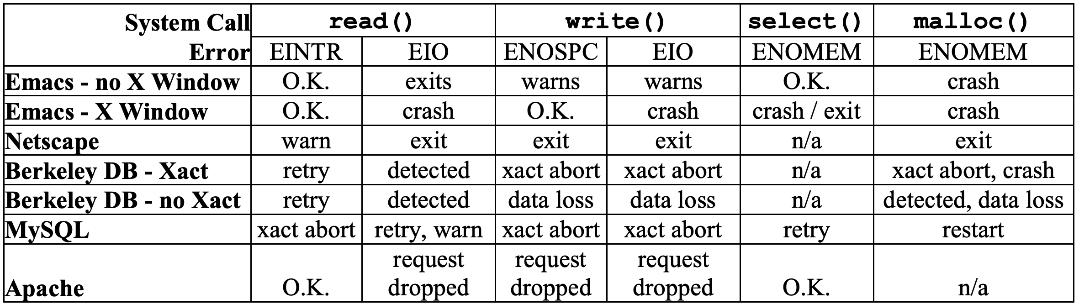
Test recovery mechanisms - fault insertion
Example: FIG - Fault Insertion in GNU C Library
<10% overhead in portable library
mature, reliable programs have poor error recovery mechanisms
Conclusion: development can benefit from testing recovery mechanisms
Reaction of applications to faults triggered in four system calls. EINTER = Interrupted system call, EIO = general I/O error, ENOSPC = insufficient disk space, ENOMEM = insufficient memory.
Fig from paper
Notes:
The first case study Is Test recovery mechanisms based on fault injection tool that finds unusual behavior. We mentioned need to test recovery systems to ensure they will work in the lessons from other fields.
* FIG (Fault Injection in C library) is a tool for triggering and logging errors at the application/system boundary. FIG interpose itself between the application and the C library. When FIG intercepts a call like a read or write call, it then chooses whether to allow the call to complete normally or to return an error that simulates a failure in the operating environment.
* To test the effectiveness of FIG, they use five mature applications: the text editor, the browser Netscape; the database Berkeley DB; the database MySQL, and the HTTP server Apache.
* Figure shows results for triggered errors in system calls read(), write(), select(), and malloc().
* THe injected faults includes interrupted sys call, I/O error, or insufficient disk/memory space
* And the result shows failure is common . E.g., Berkeley DB causes data loss and data corruption with these injected faults.
* Lesson: even mature, reliable programs have poor error recovery mechanisms.
* We conclude that application development can benefit from recovery experiments.

Slide 28
Test repair mechanisms - fault insertion
The development of "Testing recovery mechanisms" in recent 20 years:
Many research on all types of fault injection techniques in various systems
Chaos engineering widely used in production for big companies
...
Notes:
And we may have some background in fault injection because of the project.
Netflix, facebook, Uber, and so on.

Slide 29
Test repair mechanisms - fault insertion
Dependable programming practices:
Resource Preallocation (failing fast)
E.g., Apache allocated all memory at startup, avoiding malloc() failures in the middle
Graceful Degradation (roll-forward)
E.g., Apache continues service without logging if log file corrupted.
Selective Retry
E.g., ls retry malloc() errors.
Process pools
E.g., MySQL uses a pool of child processes.
Notes:
Based on their study, they also list several useful programming practices:
* Resource Preallocation. It follows the idea of failing fast, Apache allocated all necessary memory at startup, entirely avoiding malloc() failures in the middle of its processing. Encountering a failure at program initialization seems more desirable than in the middle.
* Graceful Degradation. It follows the idea of roll-forward. It offers partial service when there is a failure and allow the service to degrade gracefully. Apache: when its log file cannot be written, the rest of the service continues without interruption, but without logging.
* Selective Retry. Retrying errors is a natural solution to resource exhaustion. Waiting and retrying a failed system call can help if resources later become available. ls program uses this technique to retry malloc() errors.
* Process pools. Once the MySQL server is up and running, it provides a high degree of availability by using a pool of child processes to process queries. A child process simply restarts when it encounters an error.

Slide 30
Help Operator with Diagnosis
Root-cause analysis to suggest possible fault points in large IT services
Thousands of redundant processes
Track resource dependencies of all requests
Isolate faulty components
Example: Pinpoint
J2EE (framework for building web applications)
Added monitoring to J2EE to trace each request with
which instances of modules it uses.
success/failure info.
Find modules used only in failed requests, but not successful requests.
Limitations:
cannot distinguish between tightly coupled components
probably a latent error, faults that corrupt state and affect subsequent requests.
Source: Chen, M., E.. Pinpoint: Problem Determination in Large, Dynamic, Internet Services. DSN 2002.
Notes:
the second technique is about how to help operator with diagnose. a failing system should help the operator determine what's the root cause and what to fix, as this will reduce MTTR.
Large Internet services always have thousands of redundant computers and processes, so we need to know which instance of a module is the problem.
And the Internet services is moving fast, you cannot base on a dependency model of the components. So the challenge is to provide aids that can tracks changes in software, track resource dependencies of all requests, and isolate the fault component.
* Example of Pinpoint, works for Java EE applications.
many Internet services use middleware to construct their systems, such as Microsoft .NET or Java 2 Platform Enterprise Edition (J2EE). Seek to simplify applications by handling many details of application behavior automatically. Because of this trend, pinpoint can take advantage of it.
Added monitoring to the J2EE middleware to trace each request to see which instances of modules it uses.
Also recorded the success or failure of each user request in the trace.
We used standard data mining techniques on the traces. By analyzing the components used in the failed requests, but not used in successful requests, we find the possible root causes.
One limitation of Pinpoint is that it cannot distinguish between sets of tightly coupled components , that are always used together.
Another limitation of Pinpoint, as well as existing error determination approaches, is that it does not work with faults that corrupt state and affect subsequent requests. This interdependency makes it difficult to detect the real faults.

Slide 31
Help Operator with Diagnosis
The development in 20 years:
Trace large scale systems
more complex when not limit to a specific layer or application
web server, database, cache, DNS, etc. (E.g., Xtrace)
Log enhancement
Identifying the root cause
Traditional techniques: program slicing, delta execution, etc.
Notes:
many diagnostic tools exist, they are typically designed for a specific layer (e.g., traceroute) or application, and to reconstructing a comprehensive view of service behavior need add meta data in lower-level protocols, like IP layer.
also log enhancement, also a bunch of works, help operators know more about the faliure and possible root cause
For maybe not a large scale system there are also some traditional techinuqes maybe not for the large scale, but still useful and many works take advantage of them

Slide 32
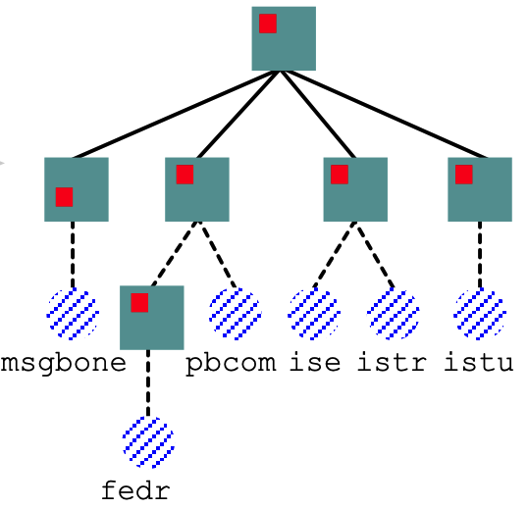
Fine Grained Partitioning and Recursive Restartability
Assumption: Reboot is an effective and efficient workaround.
Do not tolerate full restarts
long downtimes and potential data loss
Fine Grained Partitioning:
partial restarts, faster than a full reboot.
Recursive Recovery
identify failed component, restart the entire subtree
retry at a higher level
a restart tree
Source: G. Candea and A. Fox, “Recursive Restartability: Turing the Reboot Sledgehammer into a scalpel,” HotOS-VIII, May 2001
Notes:
The third technique is
* Recursive restartability is an approach that assumes that, Reboots are an effective and efficient workaround. in critical infrastructures, sometimes reboot or restart as the only means of restoring the system.
* Unfortunately, most systems do not tolerate unannounced restarts, resulting in long downtimes and potential data loss.
* This is why we need Fine-grained partitioning, that enables bounded, partial restarts that recover a failed system faster than a full reboot.
* Figure 6 shows a restart tree. Every node is a component of the system. A restart at any node results in the restart of the entire subtree rooted at that node.
Based on information of which component failed，choose a minimal set of subsystems that need restarting. If a particular restart does not cure the failure, the oracle may choose to restart at a higher level. Restarting groups that are higher up in the restart tree leads to a longer but higher-confidence recovery.
*

Slide 33
Fine Grained Partitioning and Recursive Restartability
Example: Mercury satellite ground station
Target: 100% availability of the ground station during the critical period when the satellite passes overhead.
Importance of partitioning:
Split fedr(failed often, recovered quickly) and pbcom (failed infrequently, recovered slowly)
six-fold reduction in recovery time
Nonlinear return:
Downtime during satellite passes is very expensive
large MTTF vs. fast recovery during satellite pass
Source: G. Candea and A. Fox, “Recursive Restartability: Turing the Reboot Sledgehammer into a scalpel,” HotOS-VIII, May 2001
Notes:
* Mercury, a satellite ground station in which we employed fine-grained partial restarts to reduce the MTTR by a factor of almost six. It also leads to nearly 100% availability of the ground station during the critical period when the satellite passes overhead.
* partitioning is really important here. When they split it into a part that failed often (due to JVM crashes) but recovered quickly, and a part that failed infrequently but recovered slowly. They only need to restart the subtree of fedt that can recover quickly. And they achieved a six-fold reduction in recovery time for failures occurring in fedr.
* This is another example where the cost of downtime is not linear in its length.
* Downtime under a heavy or critical workload is more expensive than downtime under a light or noncritical workload, and unplanned downtime is more expensive than planned downtime [Brewer01]. Downtime during satellite passes is very expensive because we may lose science data and telemetry.
A large MTTF does not guarantee a failure-free pass, but a short MTTR can help guarantee that we will not lose the whole pass because of a failure.

Slide 34
Reversible Systems for Operators
Operator error is the leading cause of dependability problems.
How to "recover" from operator's error?
an Undo layer: a forgiving environment for operators.
Two goals:
recover from their inevitable mistakes
retroactively repair latent errors that went undetected until too late
Case study: Undoable Email System
Source: A. Brown. Rewind, Repair, Replay: Three R's to Dependability. SIGOPS European Workshop,2002.
Notes:
The fourth technique is XXX.
From the previous study we already know that Operator error is the leading cause of dependability problems. Then How to recover from operator's error?
* undo for operators would be a significant advance. Such a system also provides a margin of safety for many hardware, software, and operator errors, since the operator can restore the system to its pre-fault state.
So here recovery we talk about software recovery, there will be consequence there will be external states and events that already happened you cannot recover.
Two week ago we discussed a paper about “Rollback-Recovery Protocols in Message-Passing Systems”. And here is different. They didn‘t target on a distributed system and don’t care about the consistency between nodes, which is much more complex.
this example is a simple case more like they provide a way to rollback the storage, like the database snapshot, only concerned with the data in the storage and not the entire behavior of the service built on top
* This case study concerns an Undo layer designed to provide a forgiving environment for human system operators. Two goals here. The first is to provide a mechanism that allows operators to recover from their inevitable mistakes. The second goal is to give operators a tool that allows them to retroactively repair latent errors that went undetected until too late.
*

Slide 35
Reversible Systems for Operators
Three R’s for recovery
Rewind: roll all system state backwards in time
Repair: change system to prevent failure
e.g., fix latent error, install preventative patch
Replay: roll system state forward, replaying user interactions lost during rewind
Notes:
* The undo model supports a 3-step undo process called “the three R’s”: Rewind, Repair, and Replay.
In the rewind step, all system state (including mailbox contents as well as OS and application hard state) is reverted to its contents at an earlier time (before the error occurred).
In the repair step, the operator can make any changes to the system he or she wants. Changes could include fixing a latent error, installing a preventative filter or patch.
Finally, in the replay step, the undo system re-executes all user interactions with the system, reprocessing them.

Slide 36
Reversible Systems for Operators
Three R’s for recovery
Rewind: roll all system state backwards in time
Repair: change system to prevent failure
e.g., fix latent error, install preventative patch
Replay: roll system state forward, replaying user interactions lost during rewind
Example of Retroactive repair
mitigate virus/spam attacks
retroactively install virus/spam filter on email server
effects are squashed on replay
Other example use cases:
accidental deletion of user mailboxes, mail corruption when redistributing user mailboxes to balance load, buggy software upgrades.
Notes:
* Retroactive repair is useful in an email system when viruses or spammers attack:
with an undo system, the operator can “undo” the system back to the point before the virus or spam attack began, retroactively install a filter to block the attack, and then “redo” the system back to the present time.
Besides this use case, the undo abstraction could be presented to the admins who accidental deletion of user mailboxes, mail corruption when redistributing user mailboxes to balance load, buggy software upgrades
also to the user, allowing the user to recover from errors such as accidentally deleting messages or folders.

Slide 37
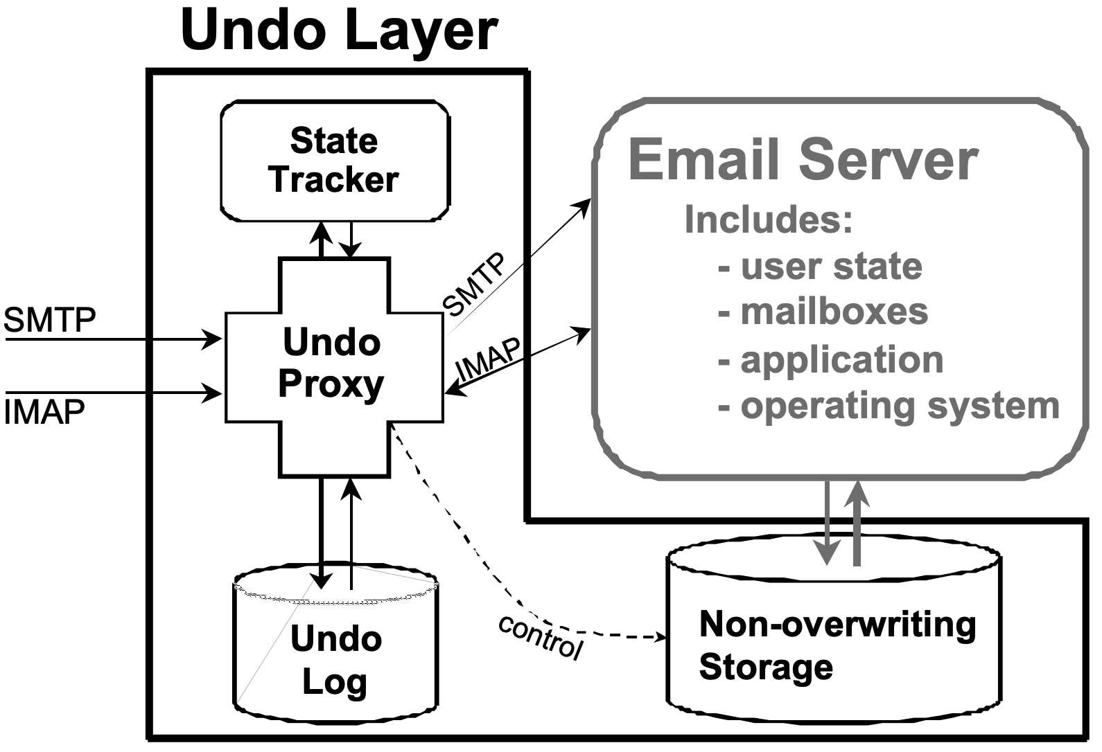
Undo layer for email system
A proxy layer
log mail delivery and user interactions
A non-overwriting storage layer
snapshot/versioning sys
Handling externalized state
E.g., undo deletes an already-read email message
issuing compensating actions
Storage overhead:
120GB disk for 1K users/year -- $50
Architecture of undo layer
Source: A. Brown. Rewind, Repair, Replay: Three R's to Dependability. SIGOPS Workshop,2002.
Notes:
We can take a look at the figure that shows their Architecture of undo layer.
It is as a proxy layer that wraps an existing, unmodified mail server.
Figure illustrates the operation of the proxy: The proxy snoops SMTP/IMAP traffic destined for the mail server and logs mail delivery and user interactions. The proxy also monitors accesses to messages and folders and uses that information to track state that has been made externally visible; this allows the system to issue appropriate compensating actions. I will talk about next.
Besides the proxy, the other major component of the prototype is a non-overwriting storage layer that sits underneath the mail server. This layer enables the rewind phase of undo by providing access to historical versions of the system’s hard state. The time-travel layer can be implemented using file system snapshots, or other more flexible versioning systems. They take advantage of the existing non-overwriting storage.
* One challenge is handling externalized state, which occurs when the undo cycle alters state already seen by an external user of the system.
In email, this problem arises when the undo cycle modifies or deletes messages that a user has already read, forwarded, or replied to;
For example, this scenario could be if the operator changes incoming mail filters during the repair stage.
We handle the resulting inconsistencies by issuing compensating actions. For example, when undo alters an already-read email message, we send a new message that explains to the user why the message was changed or deleted.
* The storage overhead of keeping the undo log for 1270 users is up to 1 GB/day for our unoptimized prototype. We consider this a modest cost to gain the 3Rs.

Slide 38
Reversible Systems for Operators
Other works in 20 years:
Snapshot for file systems and database
Checkpoint rollback recovery not used that much
Notes:
For internet services, seems the most important thing is their data so for the database field, they have a long history on reversible systems. Maybe even long before this paper is published.
We also discussed about 2 weeks ago why Checkpoint rollback recovery not used that much. Because of the scale we have, and it's complex.

Slide 39
Defense in Depth: ROC-1
Defense in depth:
independent modules can provide backup defense
Examples: firewalls from security; and error correction technique in disks.
Case study: The ROC-1 hardware prototype
cluster composed of 64 custom-built nodes, called bricks
each brick has a diagnostic processor (DP) with a separate network
DP provides an independent mechanism
monitor nodes, isolate failed nodes, insert faults.
The lesson is independent modules can provide backup defense that can improve reliability.
Notes:
The last technique they discussed is defense in depth. It suggests that independent modules can provide backup defense that can improve reliability.
Examples are firewalls from security; and disk and memory error correction to repair faults before they accessed by the application.
* The ROC-1 hardware prototype is a 64-node cluster composed of custom-built nodes, called bricks.
Unlike other PCs, each brick has a diagnostic processor (DP) with a separate diagnostic network;
the DP provides an independent mechanism to monitor nodes, to isolate failed nodes, and to insert faults.
Node isolation and fault insertion are accomplished by removing power from essential chips selectively, including the network interfaces.

Slide 40
Future work
Failure data collection, analysis, and publication
Create/run recovery benchmarks
Economically quantify the cost of downtime and ownership
Invent, evaluate techniques to reduce MTTR and TCO
Notes:
* Failure data collection, analysis, and publication. They will continue the quest for real failure data collection
* Second is develop useful availability and maintainability benchmarks. This quest helps measure progress, lower barriers to publication by researchers. They get the idea from the performance benchmarks.

Slide 41
Thank you!

Slide 42
Question
What recovery techniques are widely used today, 20 years after this paper?

